Slide 1
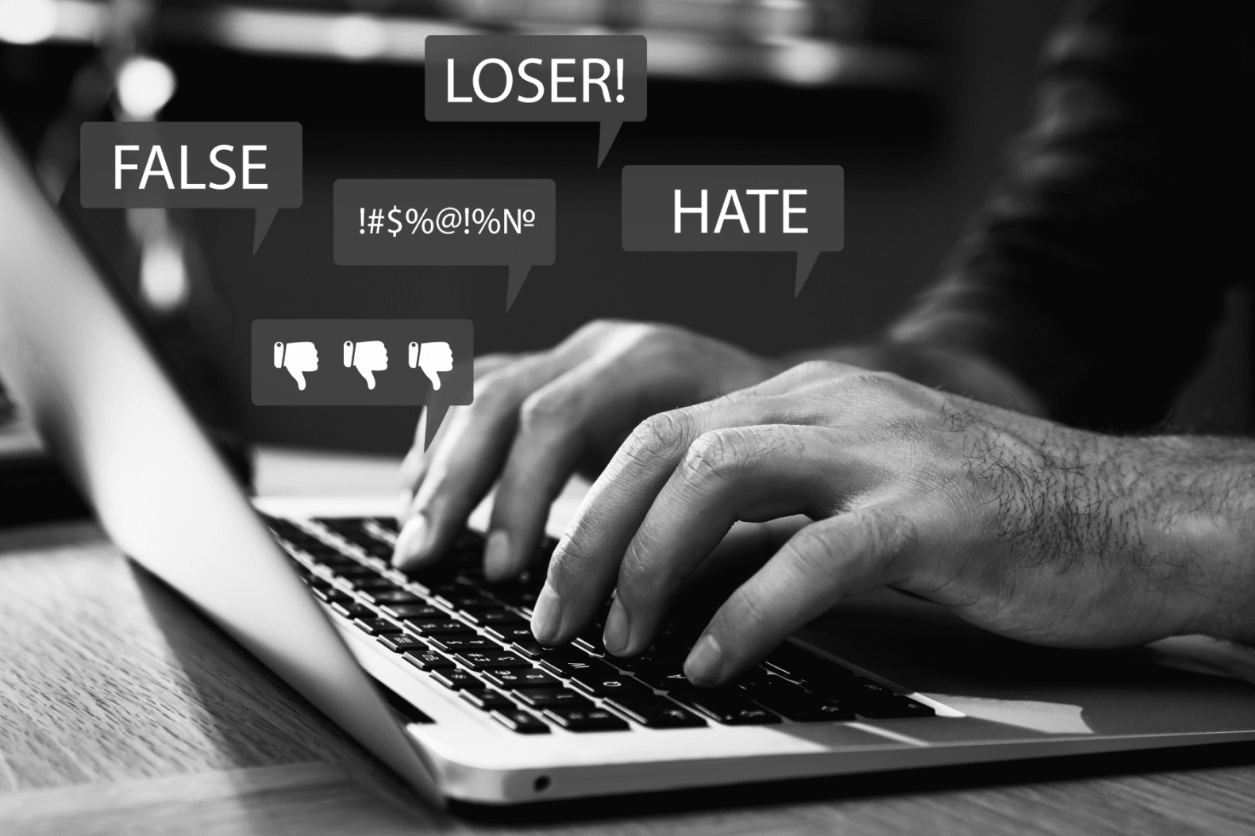
CS6120 Final Project:
Identifying and Classifying Toxic Online Behavior
Under Prof. Prashant Mittal
Group F: Ruijia Xiong, Gaurav, Jheel Kamdar, Xiaowen Sun

Slide 2

Agenda:
Introduction
Analysis & Findings
Dataset
Data Preprocessing
Models
Logistic Regression
Random Forest
CNN
LSTM
Zero-Shot Classification
Limitations & Lessons Learnt
Presenting the Notebook UI
Q & A

Slide 3
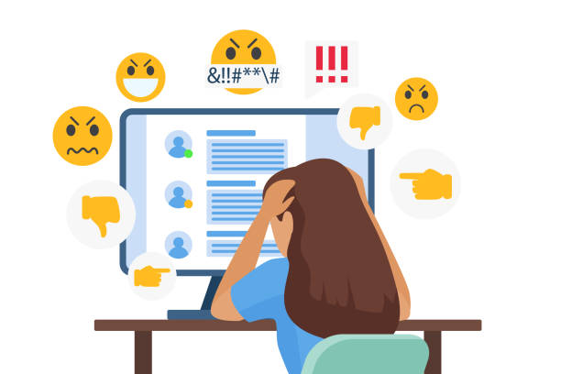

Introduction
Problem: Increased negative online behavior, including personal insults and hate speech. The threat of abuse and harassment online means that many people stop expressing themselves and give up on seeking different opinions. Platforms struggle to effectively facilitate conversations, leading many communities to limit or completely shut down user comments.
Goal: Develop a model that can predict and classify toxic texts, and facilitate to enhance safety online environments, empowering moderators to create respectful, engaging communities.
Impact:
User Engagement
Mental Wellbeing

Slide 4
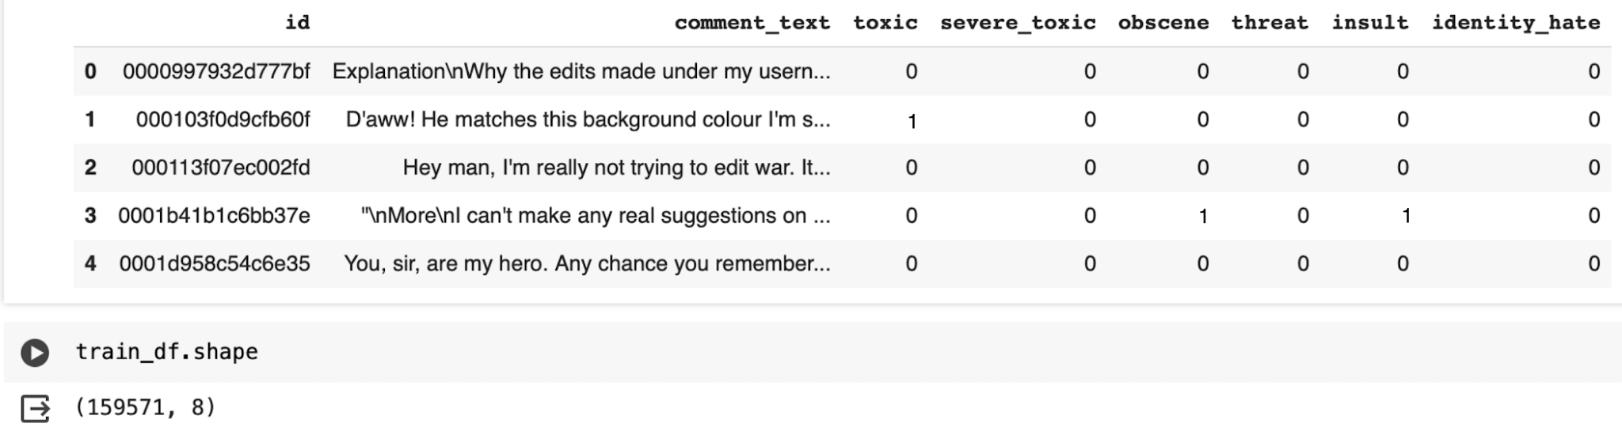
Dataset
A comprehensive dataset of Wikipedia talk page comments by Jigsaw, labeled for toxicity types by human raters. Categories include severe toxic, toxic, obscene, threat, insult, and identity hate.
Size: 160, 000 comments.

Slide 5
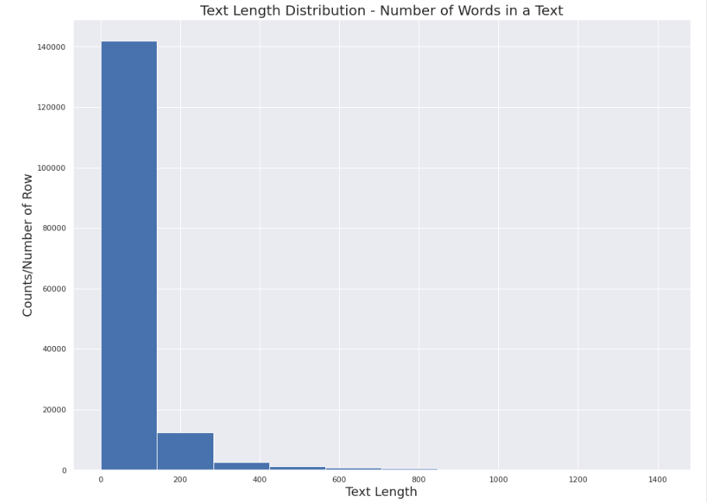
Dataset - Text Classification & Length Distribution
"\n\nCongratulations from me as well, use the tools well. \xa0· talk "
Toxic | Obscene | Threat | Insult | Identity Hate
0 | 0 | 0 | 0 | 0
Min: 1
Max: 1411
Mean: 67.3
Median: 36.0
**** *** Smith. Please have me notified when you ***. I want to dance on your *****.
Toxic | Obscene | Threat | Insult | Identity Hate
1 | 1 | 1 | 1 | 0

Slide 6
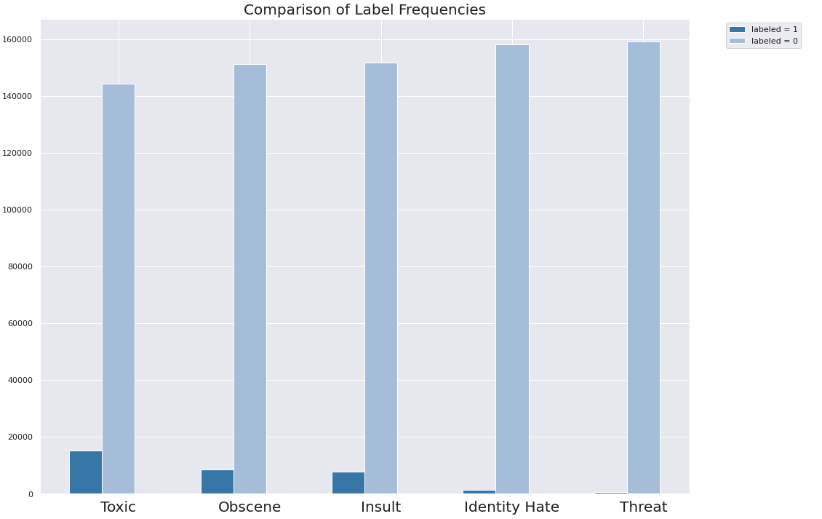
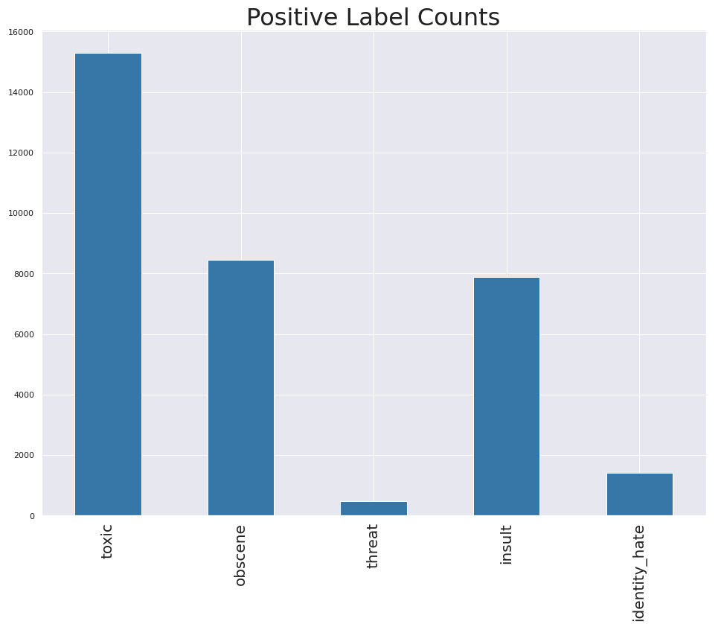
Dataset
Further analysis reveals that among all the labels, 'toxic' is the most frequently observed in the training dataset, whereas 'threat' appears the least often.
toxic 15294
obscene 8449
threat 478
insult 7877
identity_hate 1405
The plot of labeled data frequencies indicates a significant class imbalance, with the majority of comments classified as non-toxic.

Slide 7

Data Preprocessing
1. Text Cleaning
Normalization: Convert text String format, Lowercase, keep only ,.?! for special characters, removed URLs, HTML tags
Tokenization: Remove stop words. Split text into NLTK tokens.
2. Embeddings
FastText(vector size= 300): Recognized for capturing subword information, useful for understanding suffixes and prefixes.
Word2vec(vector size= 100): Because it effectively captures semantic relationships between words, allowing for more nuanced text analysis and improved performance
Average Sentence Vector: One sentence - one vector
For the UI we used the FastText, but also trained CNN on Word2Vec which gave us better results!
3. Visualization - Help understand the frequent words in each class.
youuuu
Fasttext ✅
Word2vec ❌

Slide 9
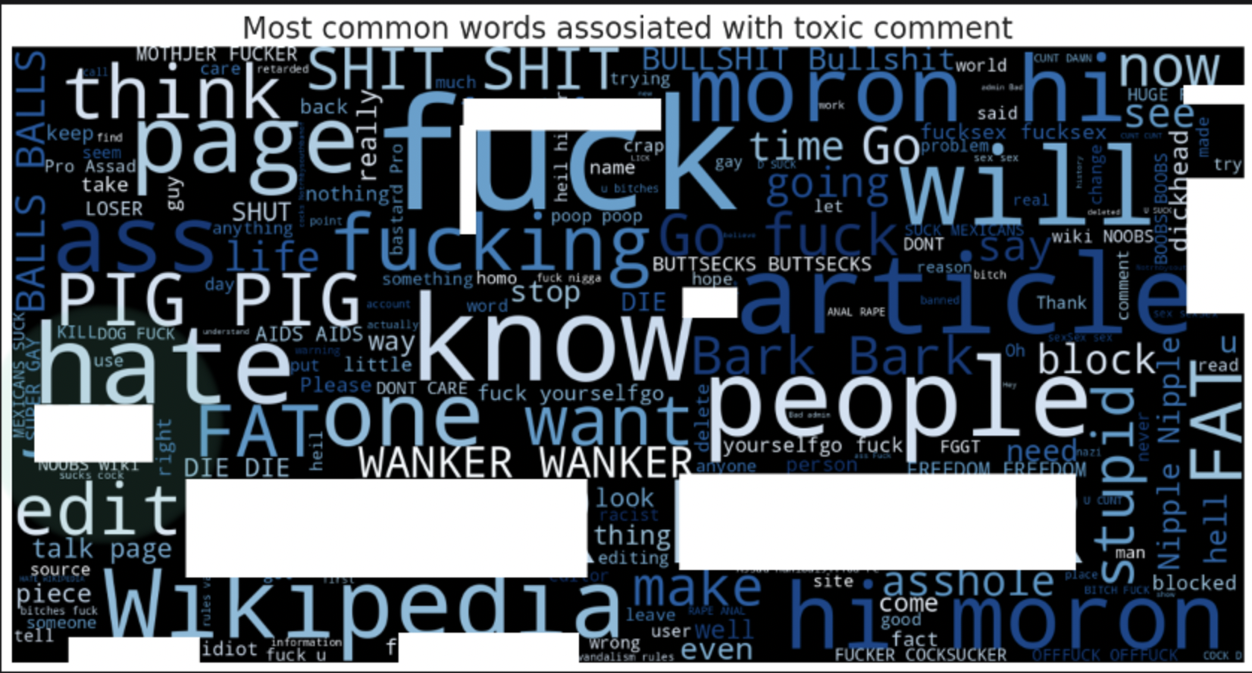
Data Preprocessing
3. Visualization:
Word Cloud Visualization: To identify and visualize frequent words and themes in the dataset, aiding in the understanding of common toxic patterns.
Example for Word Cloud Visualization:

Slide 10
Models of Choice
lr_scheduler = ReduceLROnPlateau(monitor='val_loss', factor=0.8, patience=4, verbose=1)
Logistic Regression
Utilized for its effectiveness in binary classification tasks, providing interpretable probabilities of outcomes based on predictor variable
Architecture: 3 fully connected layer, first 2 layers has dropout rate of 0.5
Random Forest with OneVSRestClassifier
Beneficial for tackling multi-class classification challenges by breaking down the problem into several binary classification subtasks, enabling efficient classification of instances into multiple classes.
CNN
2 convolutional layers + fully connected classifier
LSTM
1 LSTM layer + fully connected classifier

Slide 11
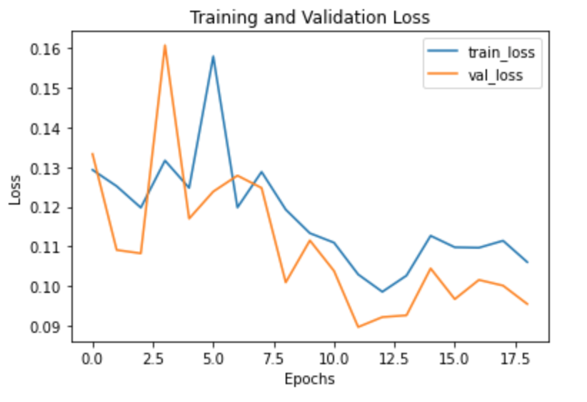
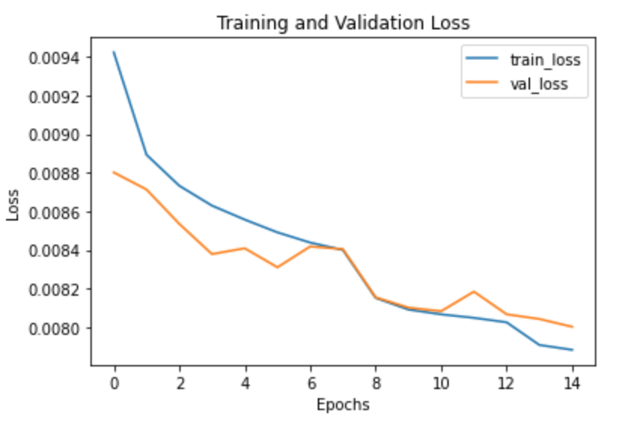
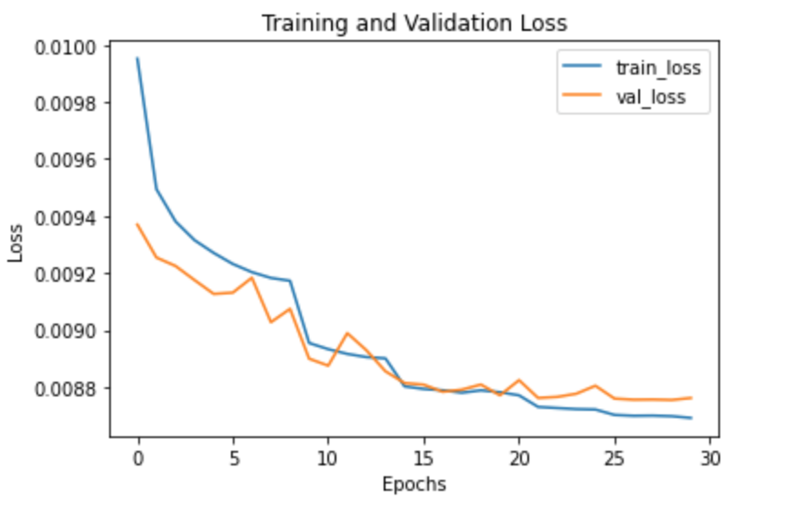
Models
LSTM
Logistic Regression
CNN

Slide 12
Different Model Prediction Comparison
LSTM is not performing as expected - Not using sequential input
 | Gross Accuracy (Row-wise) | Toxic | Obscene | Threat | Insult | Identity Hate
Logistic Regression | 0.91 | 0.94 | 0.96 | 1.00 | 0.96 | 0.99
Random Forest | 0.91 | 0.94 | 0.97 | 1.00 | 0.96 | 0.99
CNN | 0.92 | 0.94 | 0.97 | 1.00 | 0.96 | 0.98
LSTM | 0.89 | 0.91 | 0.94 | 1.00 | 0.95 | 0.99

Slide 13
Transformers: Zero-Shot Classification
Reason to use: Enables our model to predict labels for new types of toxic behavior without requiring explicit training examples for those categories.
Models:
General-purpose —— based on Multi-Genre Natural Language Inference Dataset
Roberta-large-mnli
Facebook/bart-large-mnli
Typeform/distilbert-base-uncased-mnli)
Binary Toxicity Specialized —— based on Jigsaw Toxic Comment Classification Dataset
S-nlp/roberta_toxicity_classifier
Martin-ha/toxic-comment-model
JungleLee/bert-toxic-comment-classification
Data: 200 random sampled comment data with any of the specified toxic labels

Slide 14
Models: Zero-Shot Classification
Output:
Model | Toxic | Obscene | Threat | Insult | Identity Hate
roberta-large-mnli | 0.855 | 0.590 | 0.195 | 0.575 | 0.745
facebook/bart-large-mnli | 0.780 | 0.590 | 0.180 | 0.555 | 0.695
typeform/distilbert-base-uncased-mnli | 0.265 | 0.610 | 0.270 | 0.560 | 0.780
s-nlp/roberta_toxicity_classifier | 0.850 | 0.665 | 0.220 | 0.620 | 0.255
martin-ha/toxic-comment-model | 0.635 | 0.685 | 0.365 | 0.640 | 0.450
JungleLee/bert-toxic-comment-classification | 0.955 | 0.530 | 0.070 | 0.525 | 0.120
Fine-tuned toxicity models generally outperform general-purpose models in identifying toxic behavior
Challenging in achieving uniformly high performance in all categories, especially in nuanced areas like threat.

Slide 15
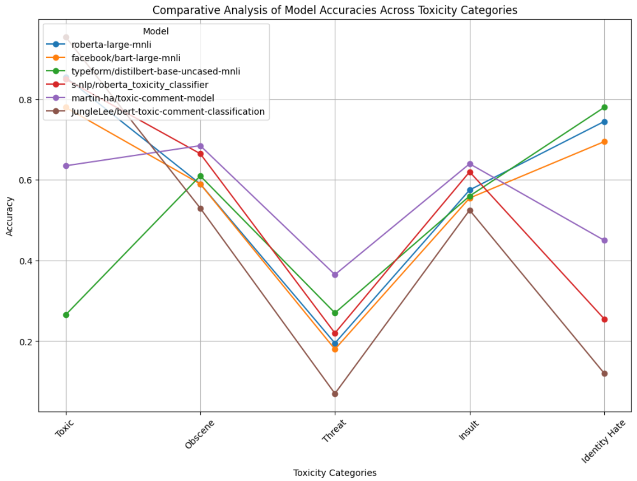
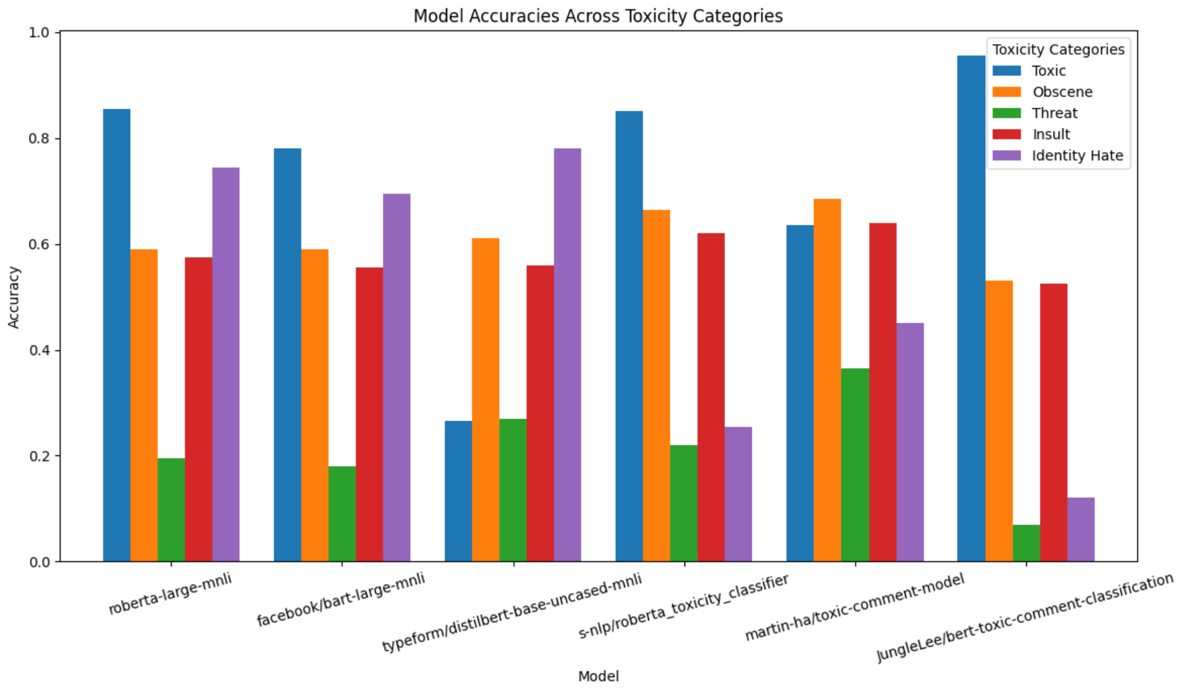
Models: Zero-Shot Classification
Output:
Fine-tuned toxicity models generally outperform general-purpose models in identifying toxic behavior
Challenging in achieving uniformly high performance in all categories, especially in nuanced areas like threat.

Slide 16
Limitation & Lessons Learnt
Limited dataset size: 160,000
Things we should try: Translations as train/test-time augmentation, to generate more text data
Computing power limit
Unable to train transformers
Bias
Dataset labels are binary.
If the labels are continuous numbers to show the degree of the toxicity, then would be better.

Slide 17
UI Presentation and Q&A

Slide 18
Thank you

